Slide 1
Source Control
Getting started with Source Control
Simon Stride May 2019

Slide 2
Why bother?
Your code is a valuable asset to yourself and your team.
As soon as you start writing code, for applications, for automation, configuration as code, or analytics – you should start thinking about Source Control.
The term Source Control refers to the tools (Version Control Systems or VCS) and processes you use to:
Store your code as a cohesive set of files
Track changes to your code over time, across multiple new or deleted files
Allow multiple copies of the codebase to exist at a point in time, using branching
Manage concurrent changes with “transactional consistency”
Notes:
Example of transactional Inconsistency:
Gemma and Luke both open the same file from a network drive without telling each other, and they both start making changes.
Gemma finishes her work and saves the file.
Luke finishes his work second and saves the file.
Luke’s save has no “knowledge” of Gemma’s work, meaning Gemma’s changes are lost
Noone notices until next time the file is opened, which may not be immediately!!

Slide 3
Picking an approach
Step one is normally to decide on the Source Control approach. At the time of writing, Git has emerged as arguably the most popular technology to host code upon, largely because Git:
Is free and Open Source in itself
Is relatively easy to learn and understand
Has a number of popular hosted implementations – e.g. GitHub, GitLab, Bitbucket
Is a “Distributed VCS” and does not require a central version/trunk
Works across OS platforms (even if your code doesn’t!)
Notes:
Git was created by Linus Torvalds in 2005 for development of the Linux kernel, with other kernel developers contributing to its initial development.^{[12]} Its current maintainer since 2005 is Junio Hamano.
https://en.wikipedia.org/wiki/Git

Slide 4




Picking a Source Control Provider
Certain vendors have different licensing and/or pricing agreements for numbers of users, numbers of projects, number of private repositories
Hosting your code with some of these software vendors has other advantages, for example integration with other products that the vendor offers.
We use Bitbucket because its free for education, doesn’t restrict the number of private repositories we can have AND integrates with Jira
Notes:
You could opt not to use a cloud SAAS provider for Git… but why make things harder?

Slide 5
Hang on, what’s a repository?
A repository (or “repo” for short) is a very much like a folder – it is essentially a root folder for all the components relating to your work.
Normally you will have one or more Repositories per Project.
For example a repository for Application A, another for Application B, another for team resources. Or, you could put all those applications in the same repo – especially if they interrelate with one another.
How you structure your project and divide by repos is up to you!

Slide 6
The idea
1. Get Latest Changes using Pull
2. Select or “Stage” my changes
3. Commit my changes
4. Push my changes
Notes:
Start by cloning a repo, then cycle through 1-4 during coding

Slide 7
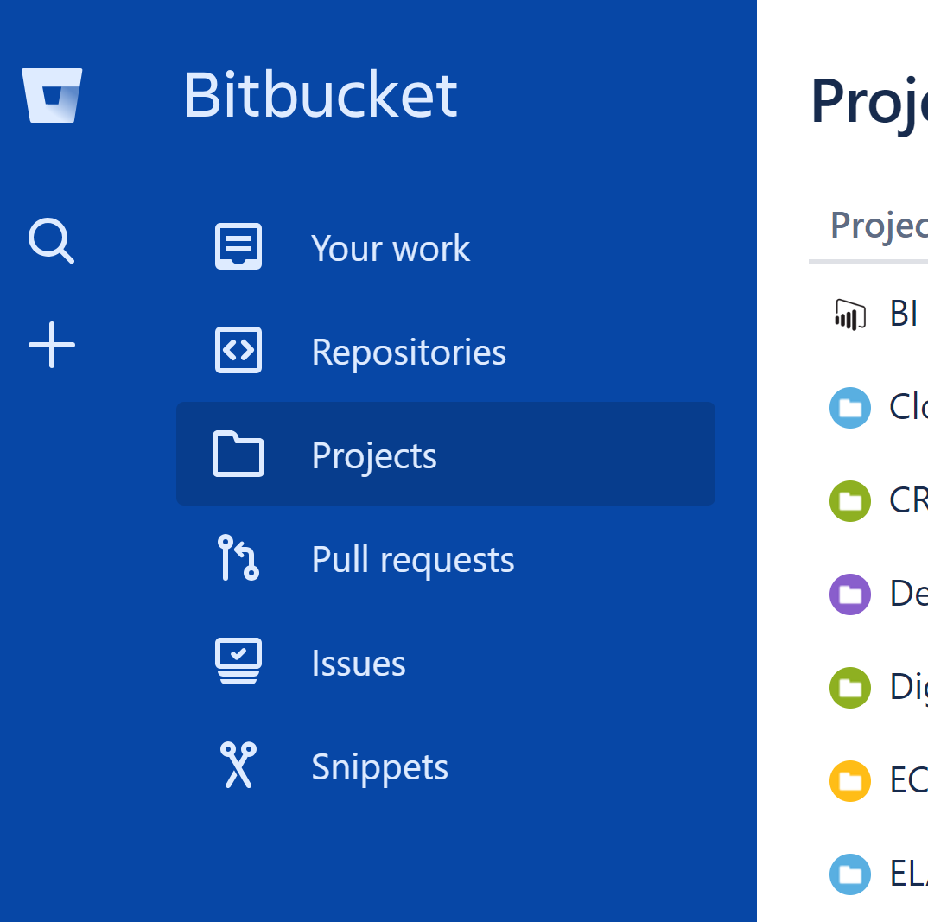
Create a New Repository
In the Bitbucket web portal, navigate to your project then click the “+” sign to create a new Repository

Slide 8
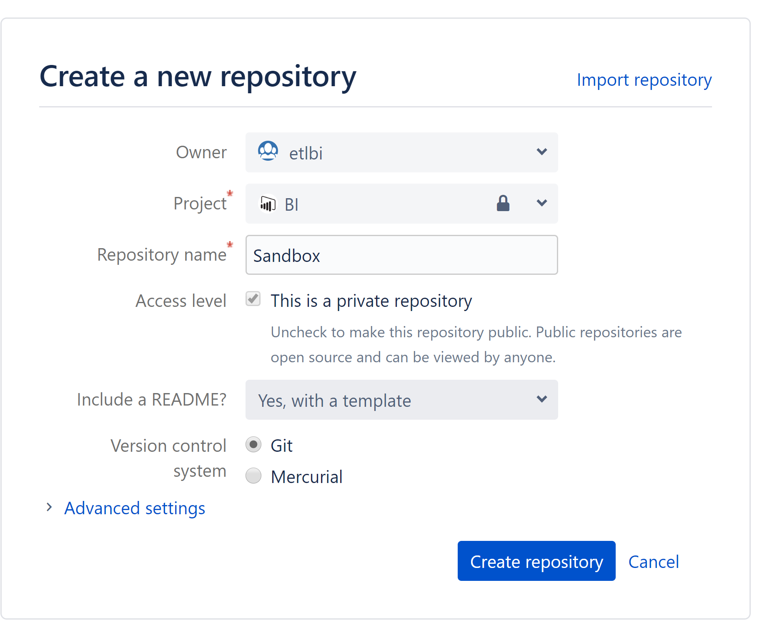
Create a New Repository
Name your repository something helpful and select a relevant owner and project. Most projects use Git for Version Control behind the scenes.
Changing the repository name later is not trivial – so try to pick something sensible upfront!

Slide 9
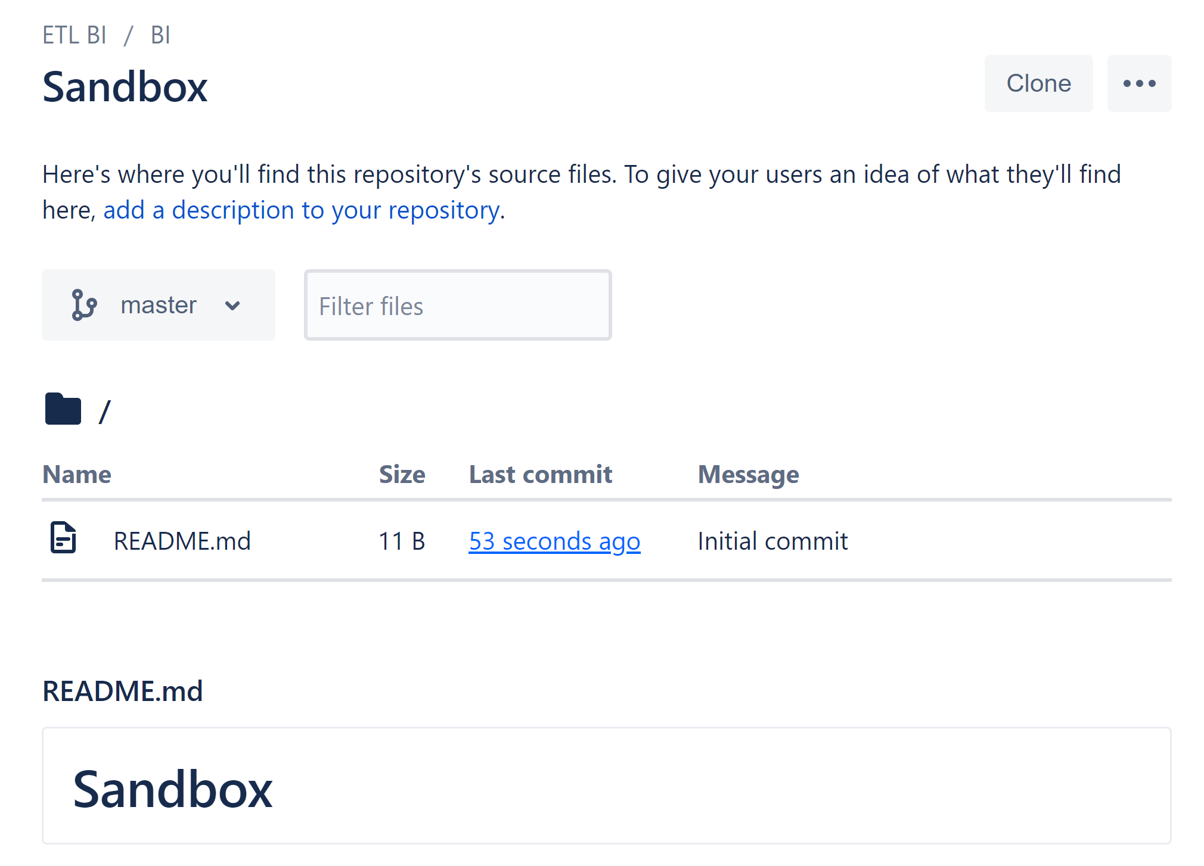
Create a New Repository
Congratulations! Your new Repository now exists in the cloud.

Slide 10
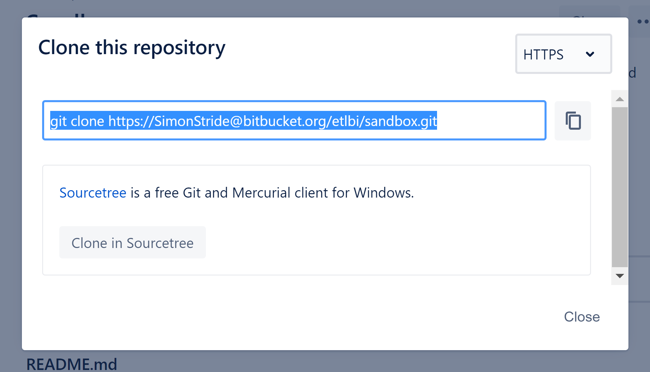
Clone Your Repository
Clone your repo to get the data down to your local development machine.
The Bitbucket portal gives you a choice of command line or SourceTree (GUI)

Slide 11
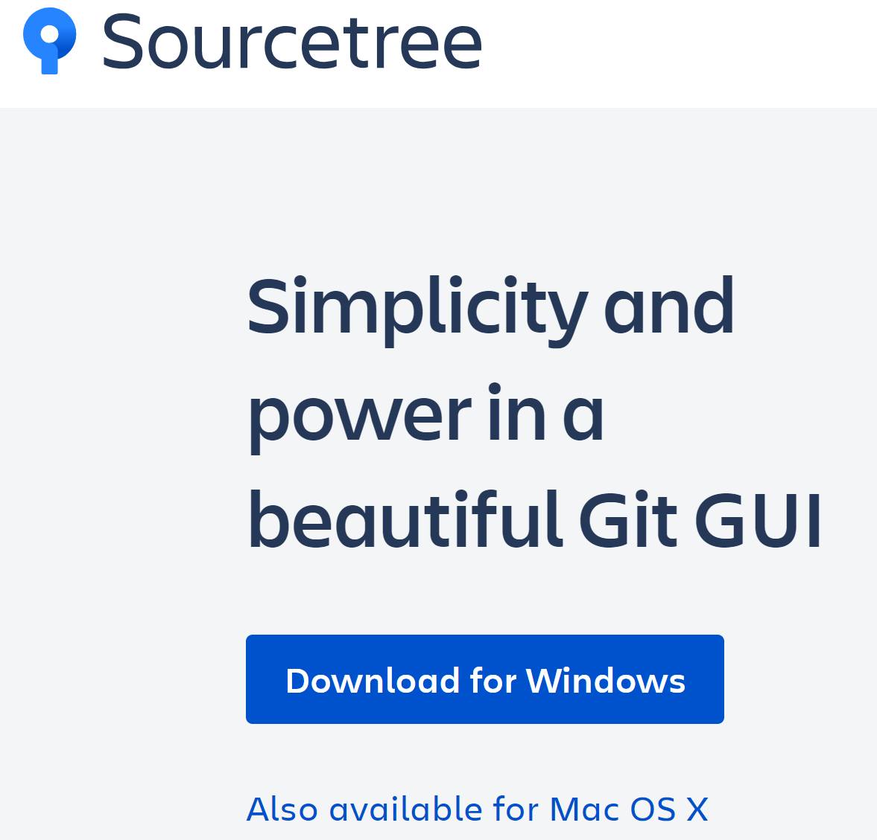
Install SourceTree
https://www.sourcetreeapp.com/
After install you will need to sign in using your Bitbucket account

Slide 12
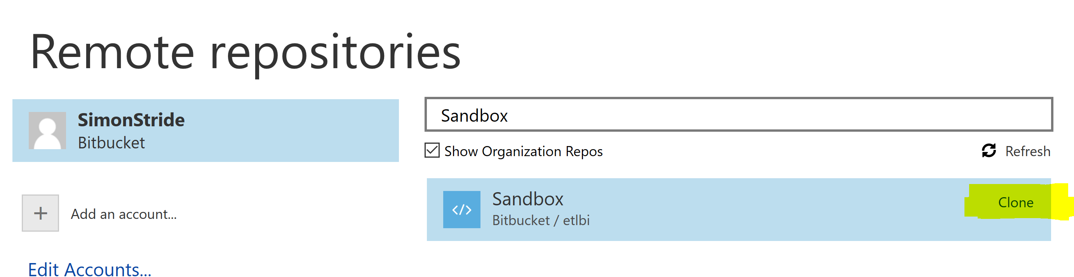
Cloning a Repo in Source Tree
Demo – Clone a repo to a folder

Slide 13
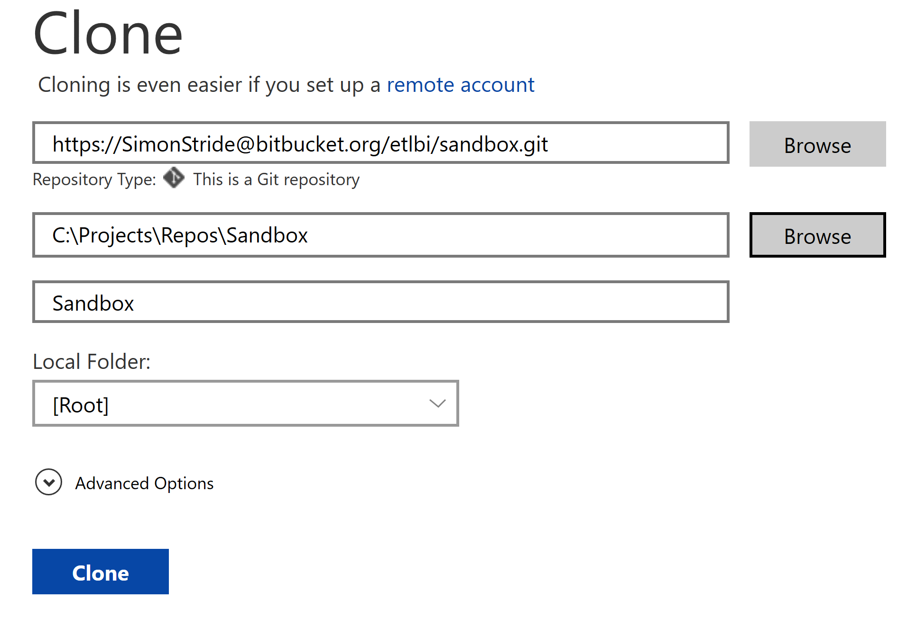
Cloning a Repo in SourceTree

Slide 14
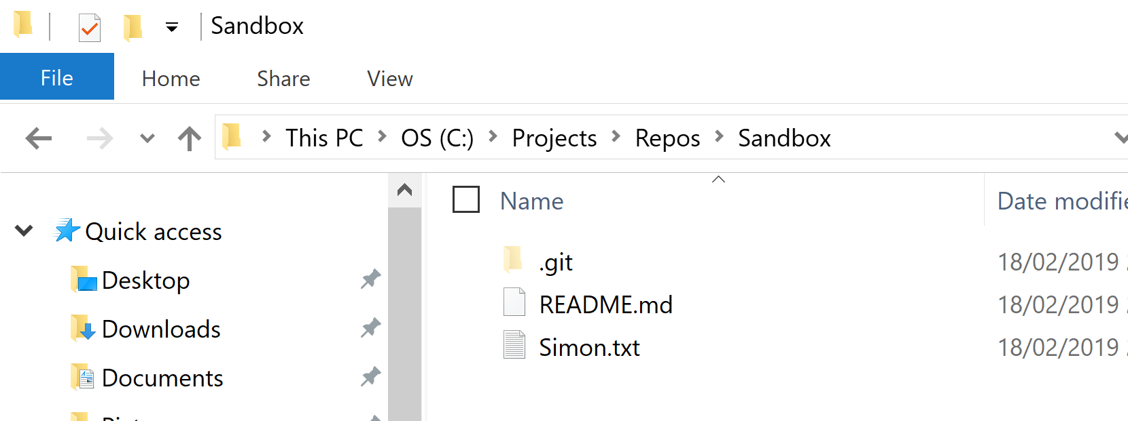
Do some work!!!
Your local repo folder will now be monitored for all changes.
Try saving a new notepad file to your folder and call it by your first name (and .txt!!!)

Slide 15
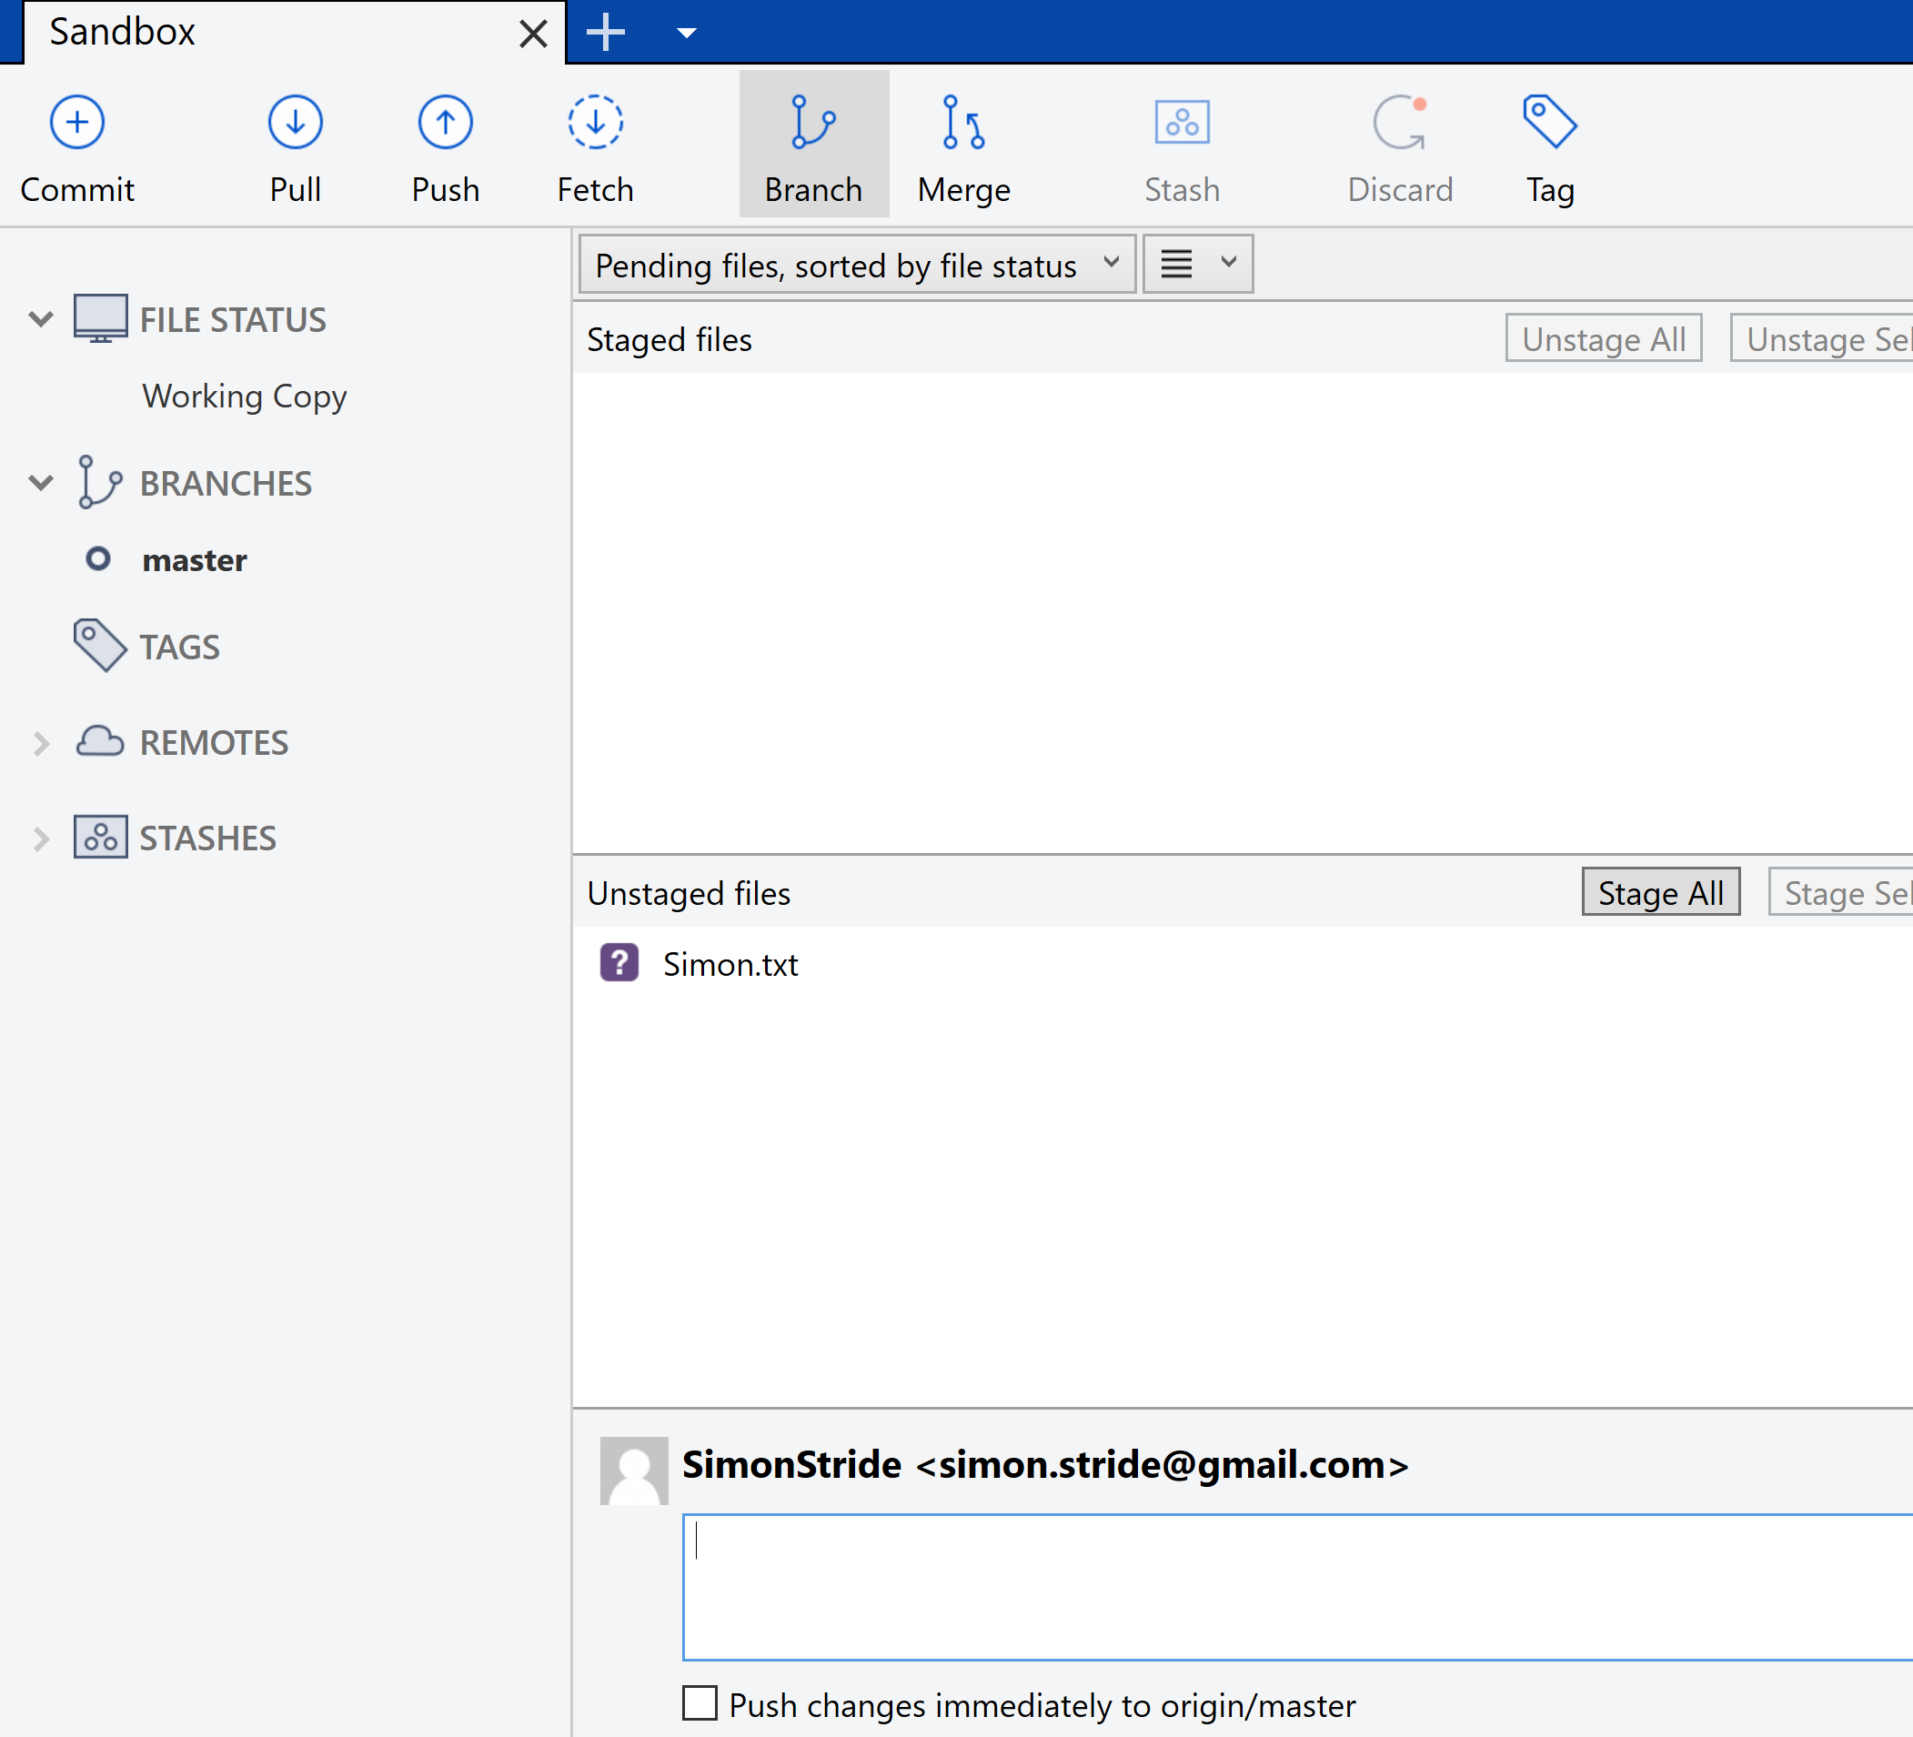
Stage and Commit SourceTree
3
In SourceTree, your new file should appear.
Click “Stage All” to confirm that the file is ready to commit
Click “Pull” to sync up
Type a commit message in the bottom box
Check the “Push changes immediately…” box
2
1
4
5

Slide 16

Check that your commit has succeeded
In the Bitbucket portal you should see your new commit message

Slide 17
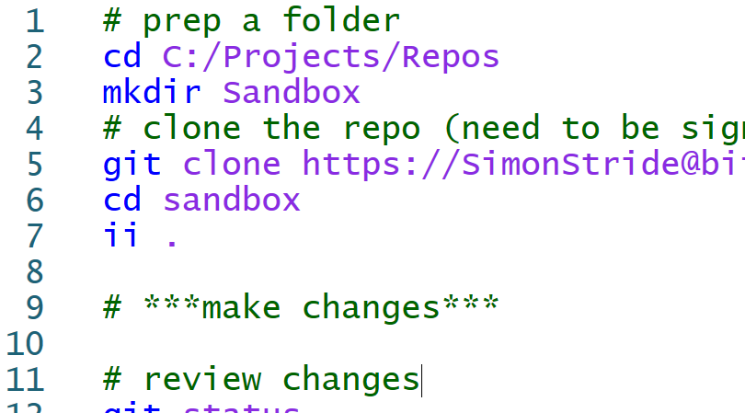
The Command Line Versions…
If you have Git installed already, run these lines one by one in PowerShell, Cmd or Bash
Remember to swap your username in and your desired root folder
# prep a folder
cd C:/Projects/Repos
mkdir Sandbox
# clone the repo (need to be signed in with Bitbucket in your browser)
git clone https://SimonStride@bitbucket.org/etlbi/sandbox.git
cd sandbox
ii .
# ***make changes***
# review changes
git status
# use stage “.” to prep all changes
git stage .
# get the latest from everyone else
git pull
# commit to Source Control with a sensible message
git commit –m “my example commit message”
# sync your changes to the rest of the world
# change this bit to commit to a different branch
git push origin master

Slide 18
Branching
Branching is a mechanism for keeping multiple copies of the same repo at the same time
For example a dev branch, test branch and release branch, each slightly behind the last in terms of updates
Branching can be extremely complex to understand and implement for beginners
If doubt, keep it simple! And seek advice from developers on similar projects
Notes:
Branching <> Forking
All branches on GitHub will be copied in a fork. (Obviously, this doesn’t include branches that were never pushed to GitHub in the first place.)
But a fork is a GitHub-to-GitHub operation; nothing is copied to your PC. It’s not quite the same as a Git clone. If you mean to ask “what’s copied when I clone a project?”, see the manual for git-clone(1).
Credit: https://stackoverflow.com/questions/5009600/difference-between-fork-and-branch-on-github

Slide 19
Pull Requests
Pull requests let you tell others about changes you've pushed to a branch in a repository on GitHub.
Once a pull request is opened, you can discuss and review the potential changes with collaborators and add follow-up commits before your changes are merged into the base branch.

Slide 20
Questions
?

